Slide 1


COLLEGE CODE: 9623
COLLEGE NAME: Amrita College of Engineering and Technology
DEPARTMENT: Artificial Intelligence and Data Science
STUDENT NM-ID: autad0008
ROLL NO: 962323243008
DATE : 22-09-2025
Completed the project named as Phase 3
TECHNOLOGY PROJECT NAME : Chat Application UI
SUBMITTED BY,
NAME : Anushiya R
MOBILE NO: 9342305214

Slide 2
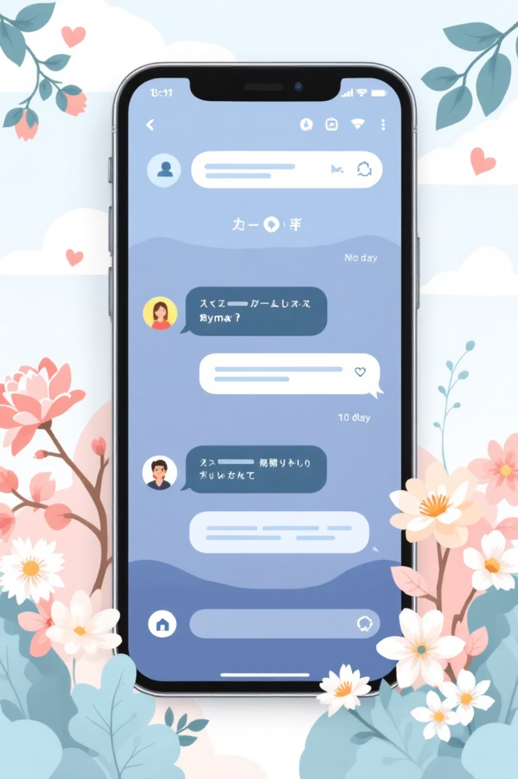
Chat Application UI
MVP Implementation
A step-by-step guide for building your first chat app
Chat Application UI

Slide 3
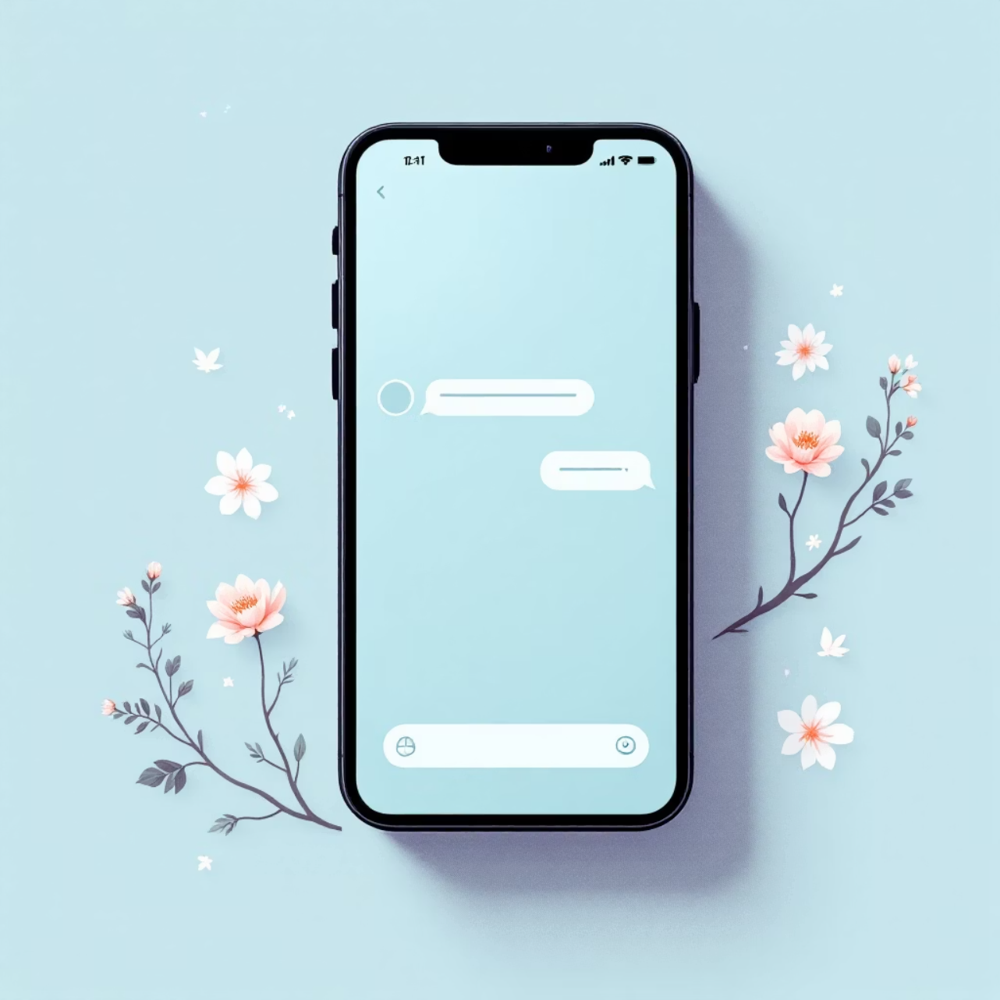
Getting Started with MVP
What is MVP?
Minimum Viable Product - core features only
Fast deployment, user feedback, iterative improvement
Why Chat Apps?
Real-time communication essential
Scalable foundation for future features
Chat Application UI

Slide 4




Technology Stack & Setup
Frontend Options
React, Flutter, or Swift
Choose based on your target platform
Backend Services
Node.js/Express or Firebase
Firestore, MongoDB, or SQLite
Development Environment
VS Code or Android Studio
GitHub for version control
Initialize Project
create-react-app or framework command
Setup Folder Structure
/components, /assets, /services, /api

Slide 5
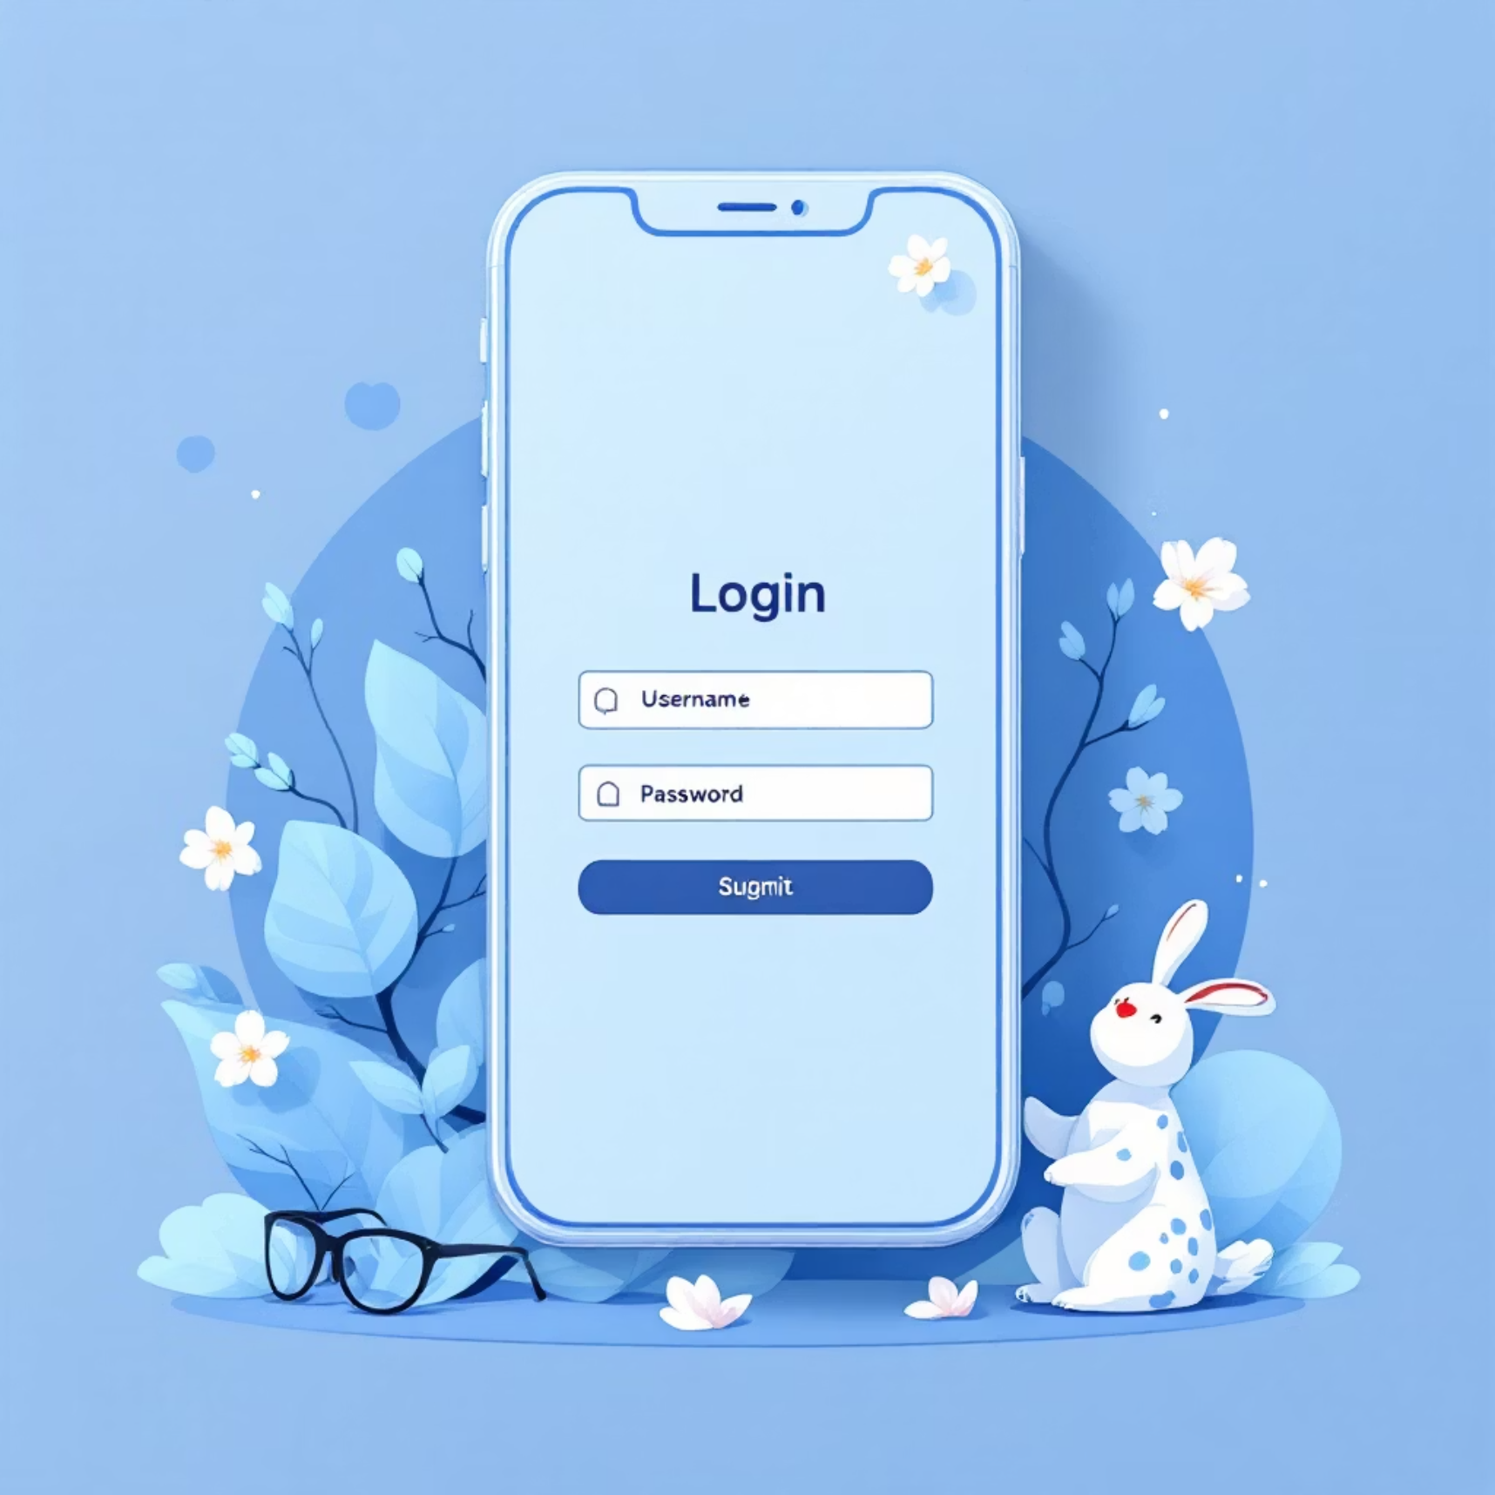

Core Features: Authentication & UI
User Authentication
Email, social media, or anonymous login
Firebase Auth or JWT tokens
Secure session management
UI Design Principles
Clean, intuitive interface
Message bubbles & input field
Mobile-first responsive design
Chat Application UI

Slide 6


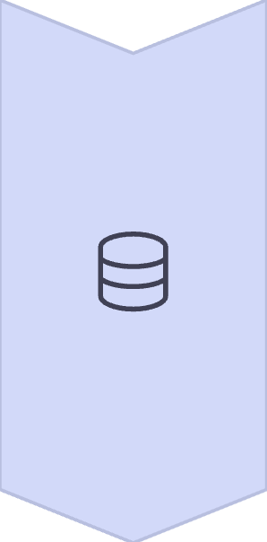
Real-Time Messaging & Storage
Real-Time Delivery
WebSockets or Firebase Realtime Database
Instant message delivery
Read receipts (optional)
Message Persistence
Local storage for offline access
Firebase or MongoDB backend
Message history sync
Chat Application UI

Slide 7
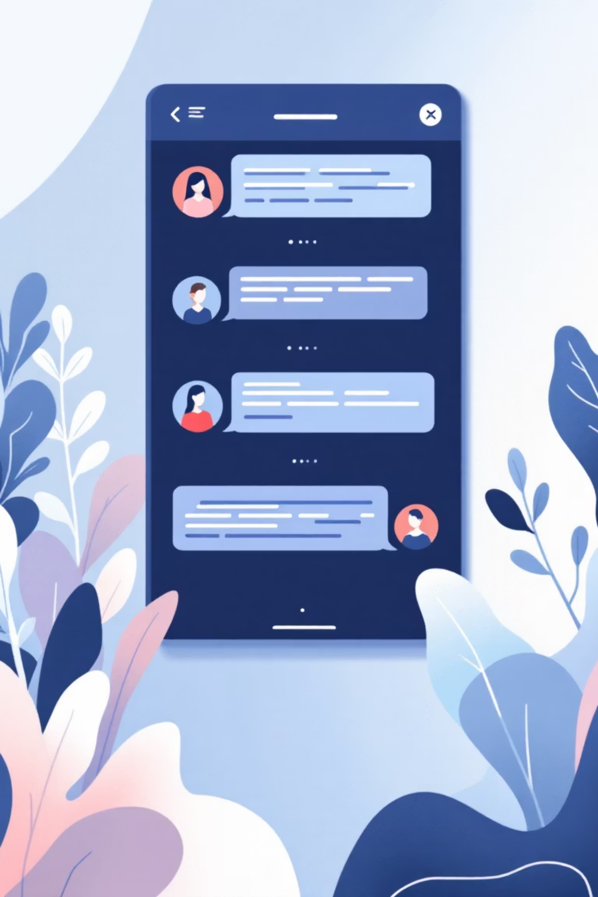
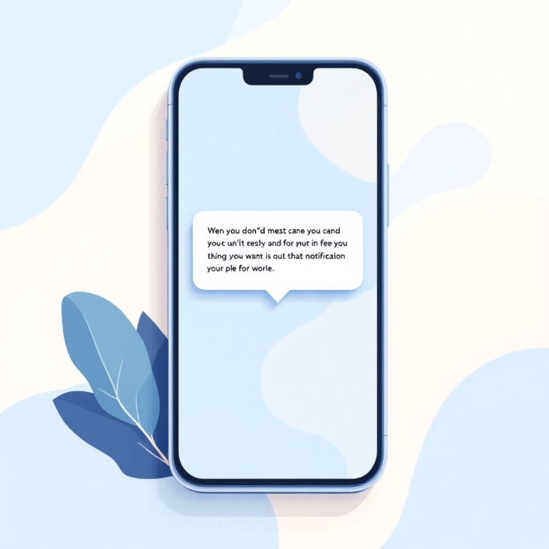
Notifications & Group Features
Push Notifications
Background message alerts
Firebase Cloud Messaging (FCM)
Chat Rooms & Groups
Create and manage group chats
Member roles and permissions

Slide 8
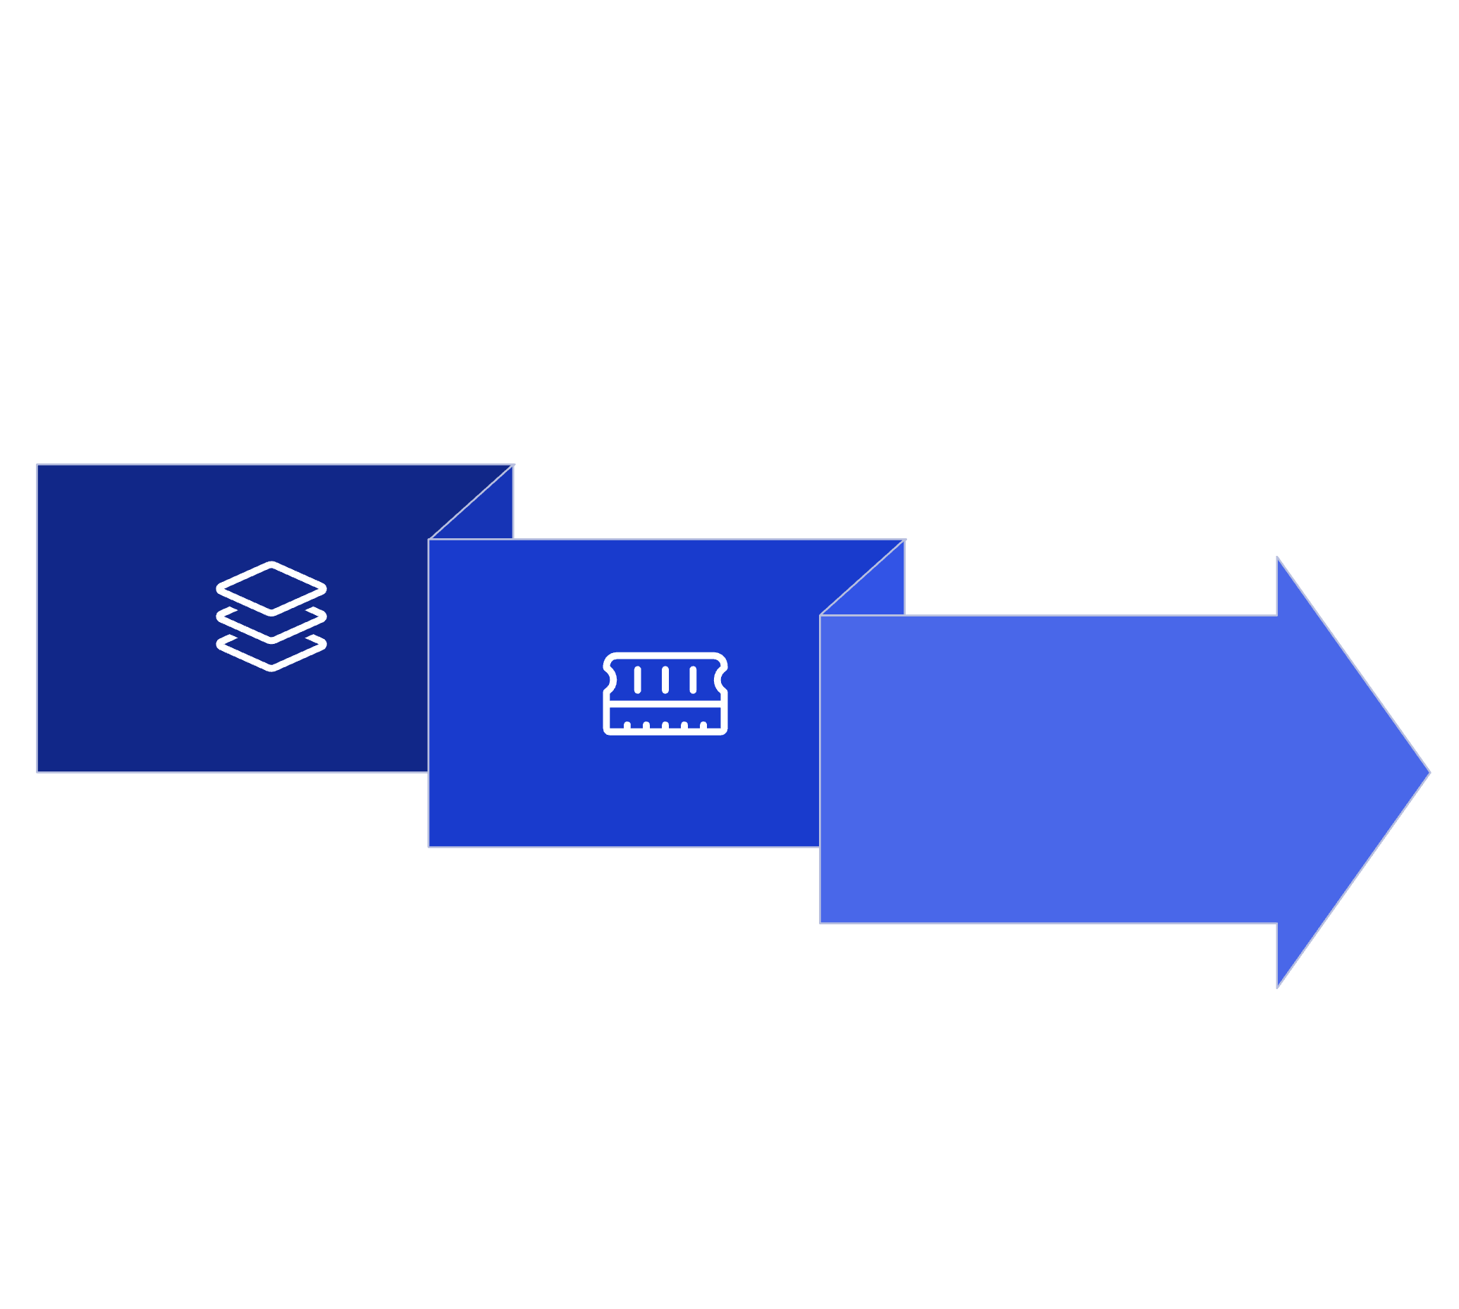


Data Management Strategy
Context API / Redux
Firebase / MongoDB
Session Memory
Chat Application UI
1
2
Local State Management
Persistent Database Storage
Context API or Redux for global state
Firebase Firestore for scalability
Temporary session and active chat data
User profiles and message history

Slide 9

Testing Your Chat App
1
Unit Testing
Jest for individual components
Test Message, ChatBubble, Login forms
Core logic: send/receive, authentication
2
End-to-End Testing
Cypress for complete user flows
Login → send messages → notifications
Multi-device simulation
Chat Application UI

Slide 10








Version Control with GitHub
Feature Branches
Master/Main Branch
feature/chat-ui, feature/auth
Stable, production-ready code
Pull Requests
Code reviews and merging
Pro Tip: Commit often with meaningful messages like "Implemented message sending functionality"
Chat Application UI

Slide 11

You're Ready to Build!
5
3
1
Core Features
Testing Phases
MVP Goal
Authentication, messaging, storage, notifications, groups
Unit tests, integration tests, end-to-end validation
Functional chat app ready for user feedback
Start building, test thoroughly, iterate based on feedback

